Slide 1

AUTOMATE.CENTRALIZE.STREAMLINE
Recall Wire® Confidential – Do not copy, distribute or use without Recall Wire written permission (2025)

Slide 2
AUTOMATION
REAL TIME RECALL NOTIFICATIONS AVERAGING 25-45 DAYS FASTER THAN FDA AND TRADITIONAL RECALL PROCESSING
AI BACKED PLATFORM RECEIVES RECALL NOTIFICATIONS AND AUTOMATICALLY TRANSMITS TO THE RESPONSIBLE PARTY
IDENTIFY AFFECTED INVENTORY – IMMEDIATELY PULL PRODUCT OFF SHELVES – TRACK ALL ACTIONS
FULL VISIBILITY OF PRODUCT RECALL LIFE CYCLE FROM START TO FINISH
“TAKE MATTERS INTO YOUR OWN HANDS. THINK FORWARD.”
Recall Wire® Confidential – Do not copy, distribute or use without Recall Wire written permission (2025)

Slide 3
CENTRALIZE
LIVE WEB-BASED TRAINING. MANAGEMENT TRAINING. CUSTOMER SERVICE RAPID RESPONSE TEAM.
CONNECT AND OVERSEE ALL FACILITIES AND DEPARTMENTS WITHIN YOUR COMPANY
PROCESS RECALL NOTICES THROUGH RECALL WIRE TO IMMEDIATELY LOCATE AND NOTIFY USERS.
AUTOMATICALLY SEND NOTIFICATIONS TO AFFECTED FACILITIES/STORES/LOCATIONS.
ENSURE RECALLS ARE HANDLED IN REAL-TIME TO ENSURE QUALITY AND SAFETY.
REDUCE PATIENT EXPOSURE TO LIFE THREATENING PRODUCT AND SAVE LIVES
Recall Wire® Confidential – Do not copy, distribute or use without Recall Wire written permission (2025)

Slide 4
CENTRALIZE
Tier 1 – Recall Coordinator Oversees inventory in their department(s) Receives direct emails from platform requesting inventory checks, has access to enter data in the platform, and closes recalls.
Tier 2 – Materials Manager/Facility Point Person Receives direct emails from platform requesting inventory checks. Can re-route to other department if needed. Can close out recalls on other departments behalf. Can add / remove users.
Tier 3 – Recall Manager/Administrator
Oversees. Can escalate. Can update and close recalls. Can re-route recalls to other departments. Can add/remove users. Can add/remove departments. Has access to reporting tools.
Recall Wire® Confidential – Do not copy, distribute or use without Recall Wire written permission (2025)

Slide 5
STREAMLINE
FDA RECALLS (CLASS 1, 2, 3 AND EARLY ALERTS) ARE AUTOMATICALLY SCREENED AGAIN YOUR PURCHASE ORDER HISTORY, ITEM MASTER, INVENTORY MASTER, ETC.
NON-FDA RECALLS CAN BE SUBMITTED BY ANYONE WITHIN AN ORGANIZATION, SIMPLY BY UPLOADING THE ATTACHMENT (PDF, TIF, EXCEL) ONCE THIS OCCURS, THE DATA IS SEARCHED AND ANY/ALL AFFECTED PRODUCTS ARE IDENTIFIED AND EMAILS ARE AUTOMATICALLY SEND TO THE RESPONSIBLE PARTIES TO CHECK THEIR INVENTORY.
ONCE END USERS COMPLETE THEIR TASK. RECALLS CAN BE CLOSED OR FINAL ACTIONS CAN BE TRACKED.
ESCALATIONS / DEPARTMENTS MAPPING / INTEGRATIONS CAN ALL BE CUSTOMIZED TO YOUR ORGANIZATION.
CUSTOMS REPORTS BACKED BY AI GIVING BIRDS-EYE VIEW INSIGHT DOWN TO THE MOST GRANULAR DETAIL.
RECALL WIRE WILL KEEP TRACK OF ALL YOUR RECALL RESPONSE FORMS.
CUT COSTS BY REMOVING POTENTIALLY HARMFUL PRODUCTS FROM THE SHELVES FASTER.
PROCESSING TIME IS DECREASED BY 95% - WORK SMARTER, NOT HARDER.
Recall Wire® Confidential – Do not copy, distribute or use without Recall Wire written permission (2025)

Slide 6
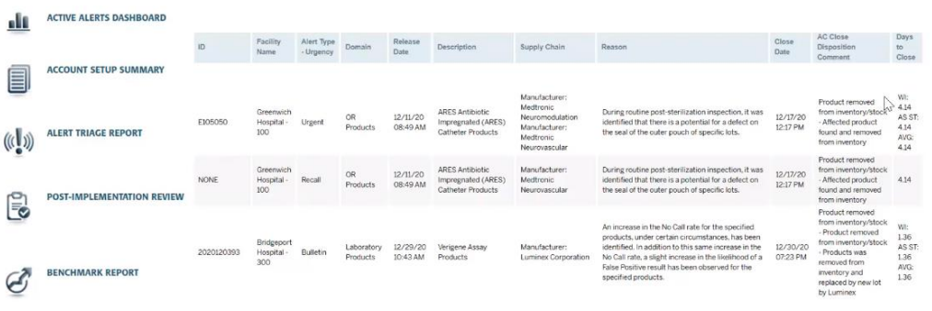
REPORTING
Recall Wire® Confidential – Do not copy, distribute or use without Recall Wire written permission (2025)

Slide 7
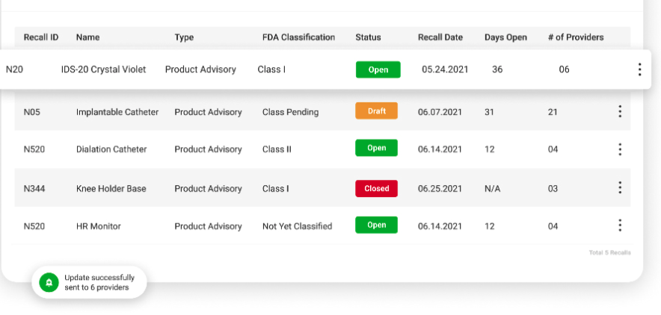
DASHBOARD
Recall Wire® Confidential – Do not copy, distribute or use without Recall Wire written permission (2025)

Slide 8
SAVE TIME
SAVE MONEY
SAVE LIVES
Recall Wire® Confidential – Do not copy, distribute or use without Recall Wire written permission (2025)

